Slide 1
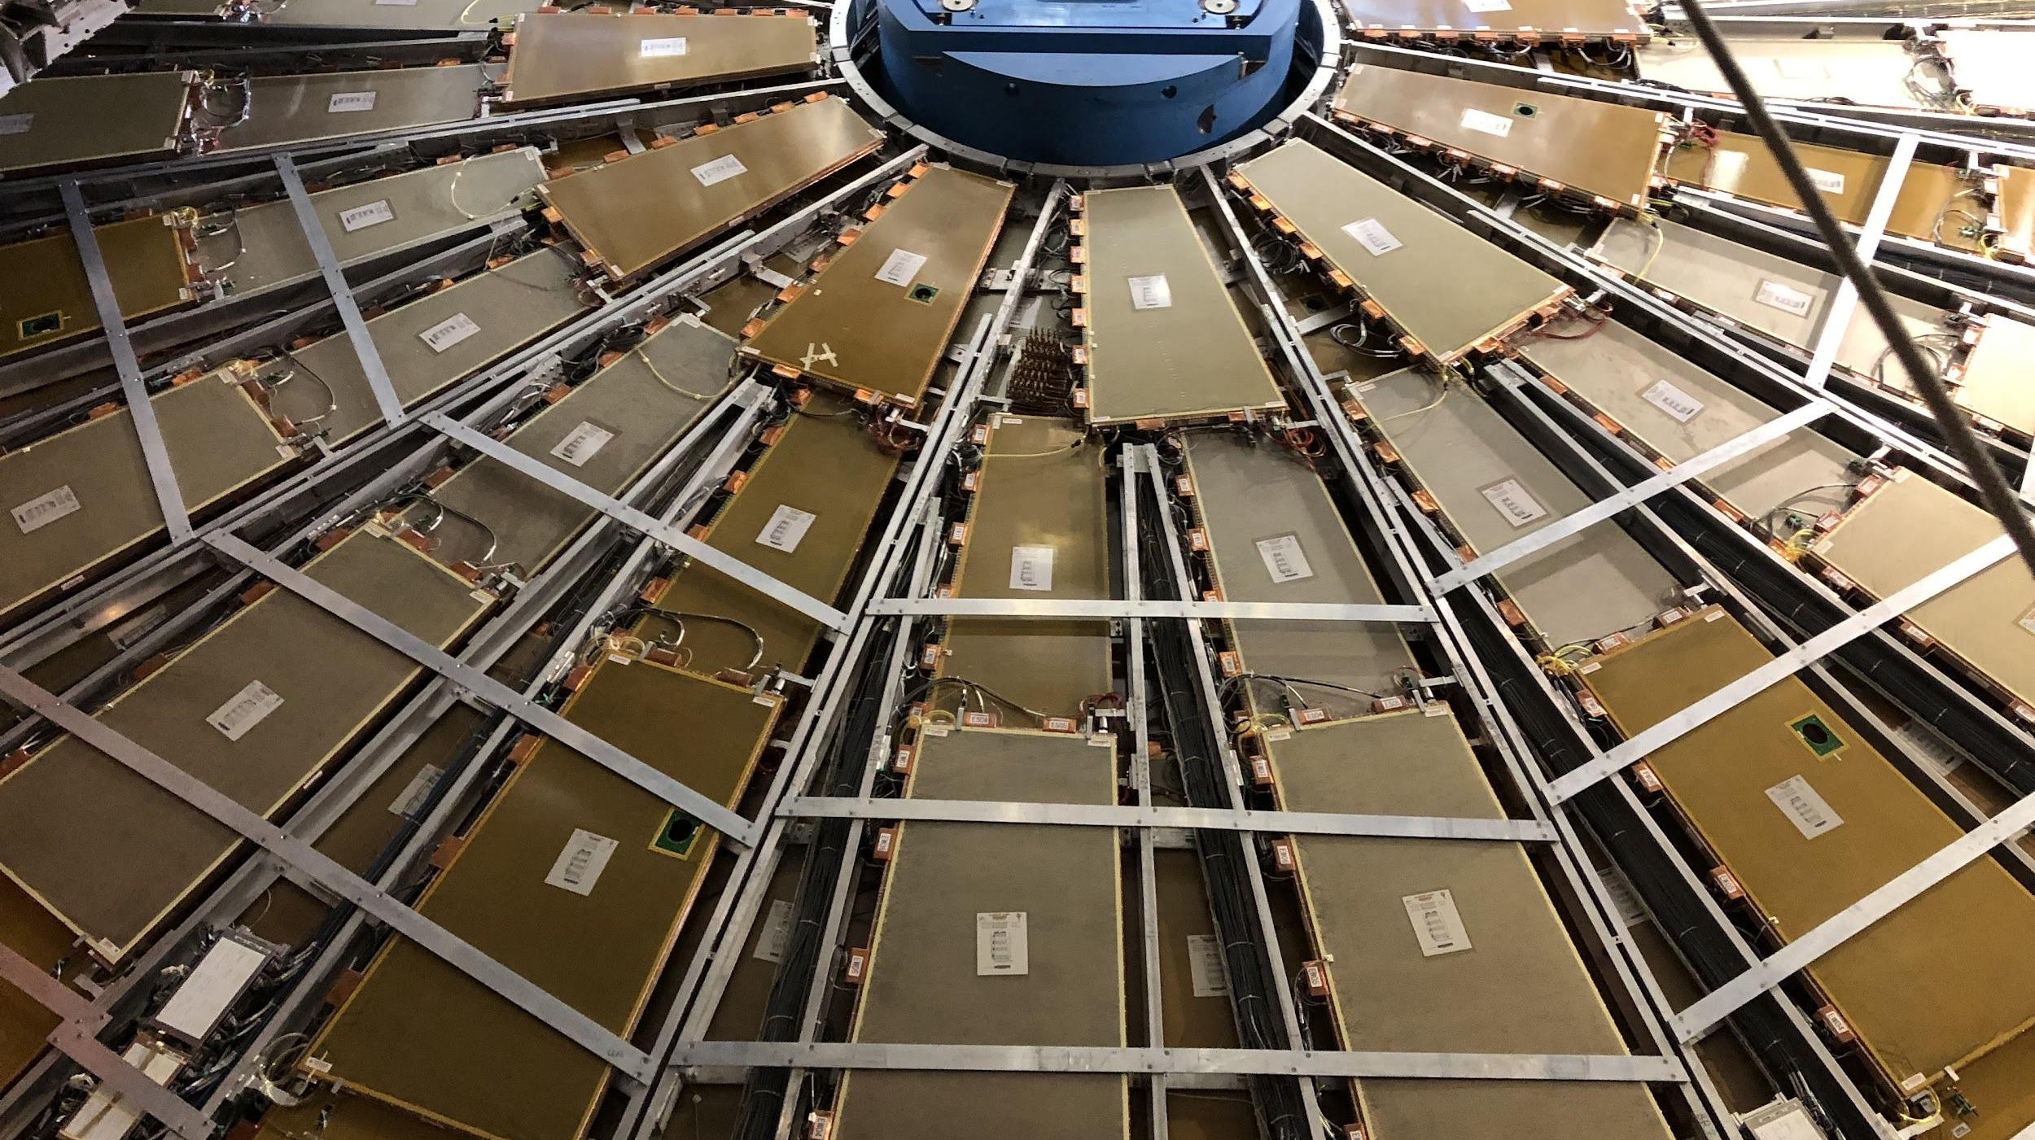

Maintenance & Consolidation Status
Hardware, Maintenance, & Operation Session, 16 February 2022
Dawit Belayneh, Katie Hughes, and Chris Thomas on behalf of the Maintenance Team

Slide 2
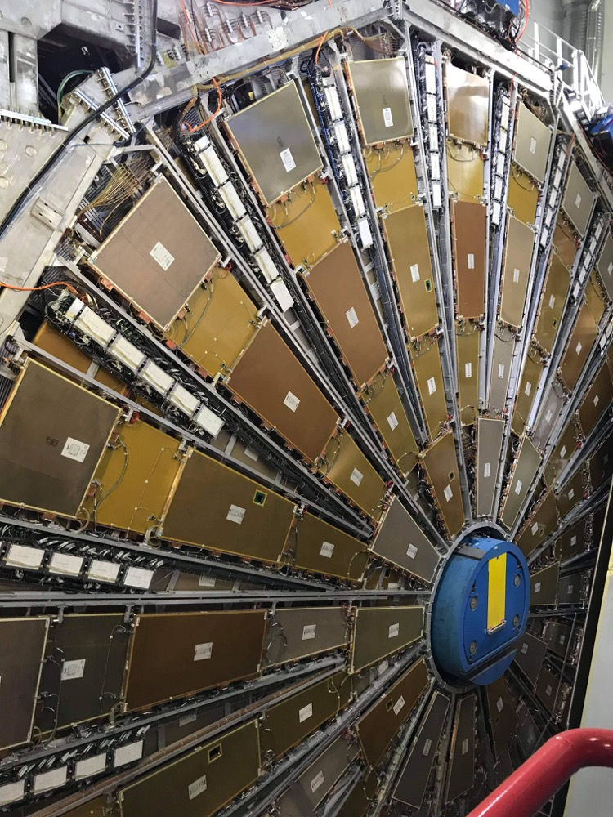
Outline
Cooling Valve Installations
Motivation
Installation Procedure
Commissioning
Maintenance work
Cooling Leaks

Slide 3
Cooling Valve Installations

Slide 4
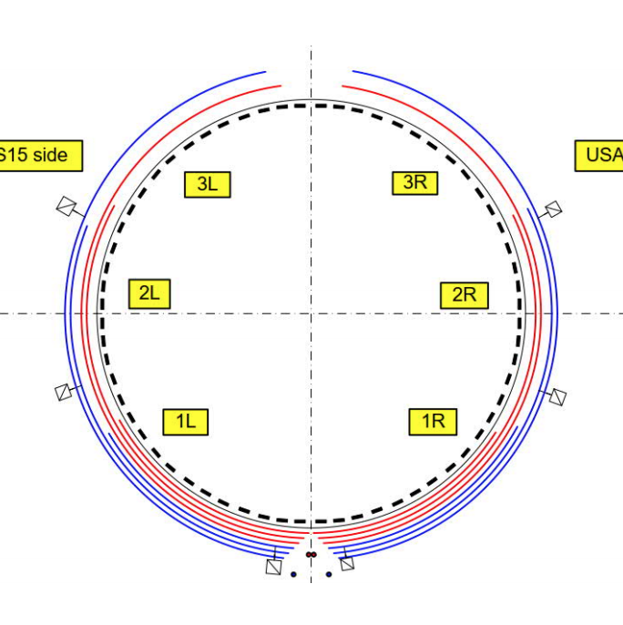
Motivation
Single cooling loop passes through 8-12 drawers
6 loops per partition
A leak in one drawer can provoke ineffective cooling for all other drawers in the loop. To fix it, all drawers in the loop must be shut down.
Valves will now isolate leaks to a single drawer
Cooling Loop Distribution

Slide 5
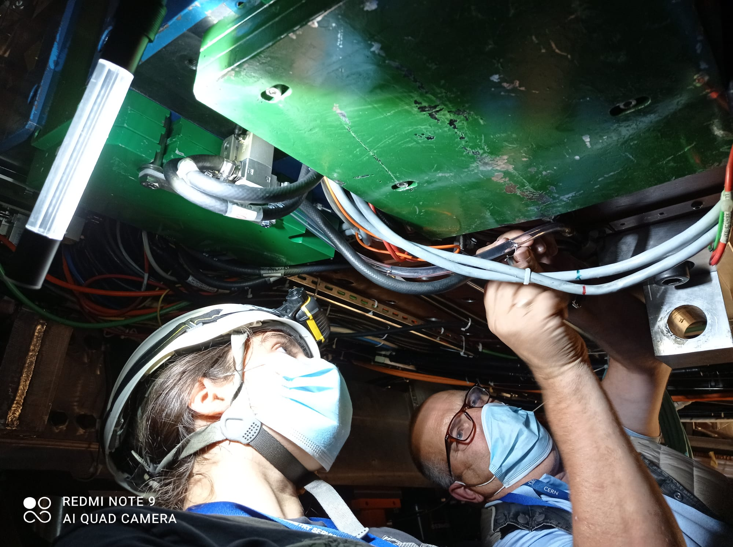
Procedure
Build and test valves
Mount brackets with valves on drawers
Stop cooling loops, connect hoses to valves, restart loops and check for leaks
Commissioning

Slide 6
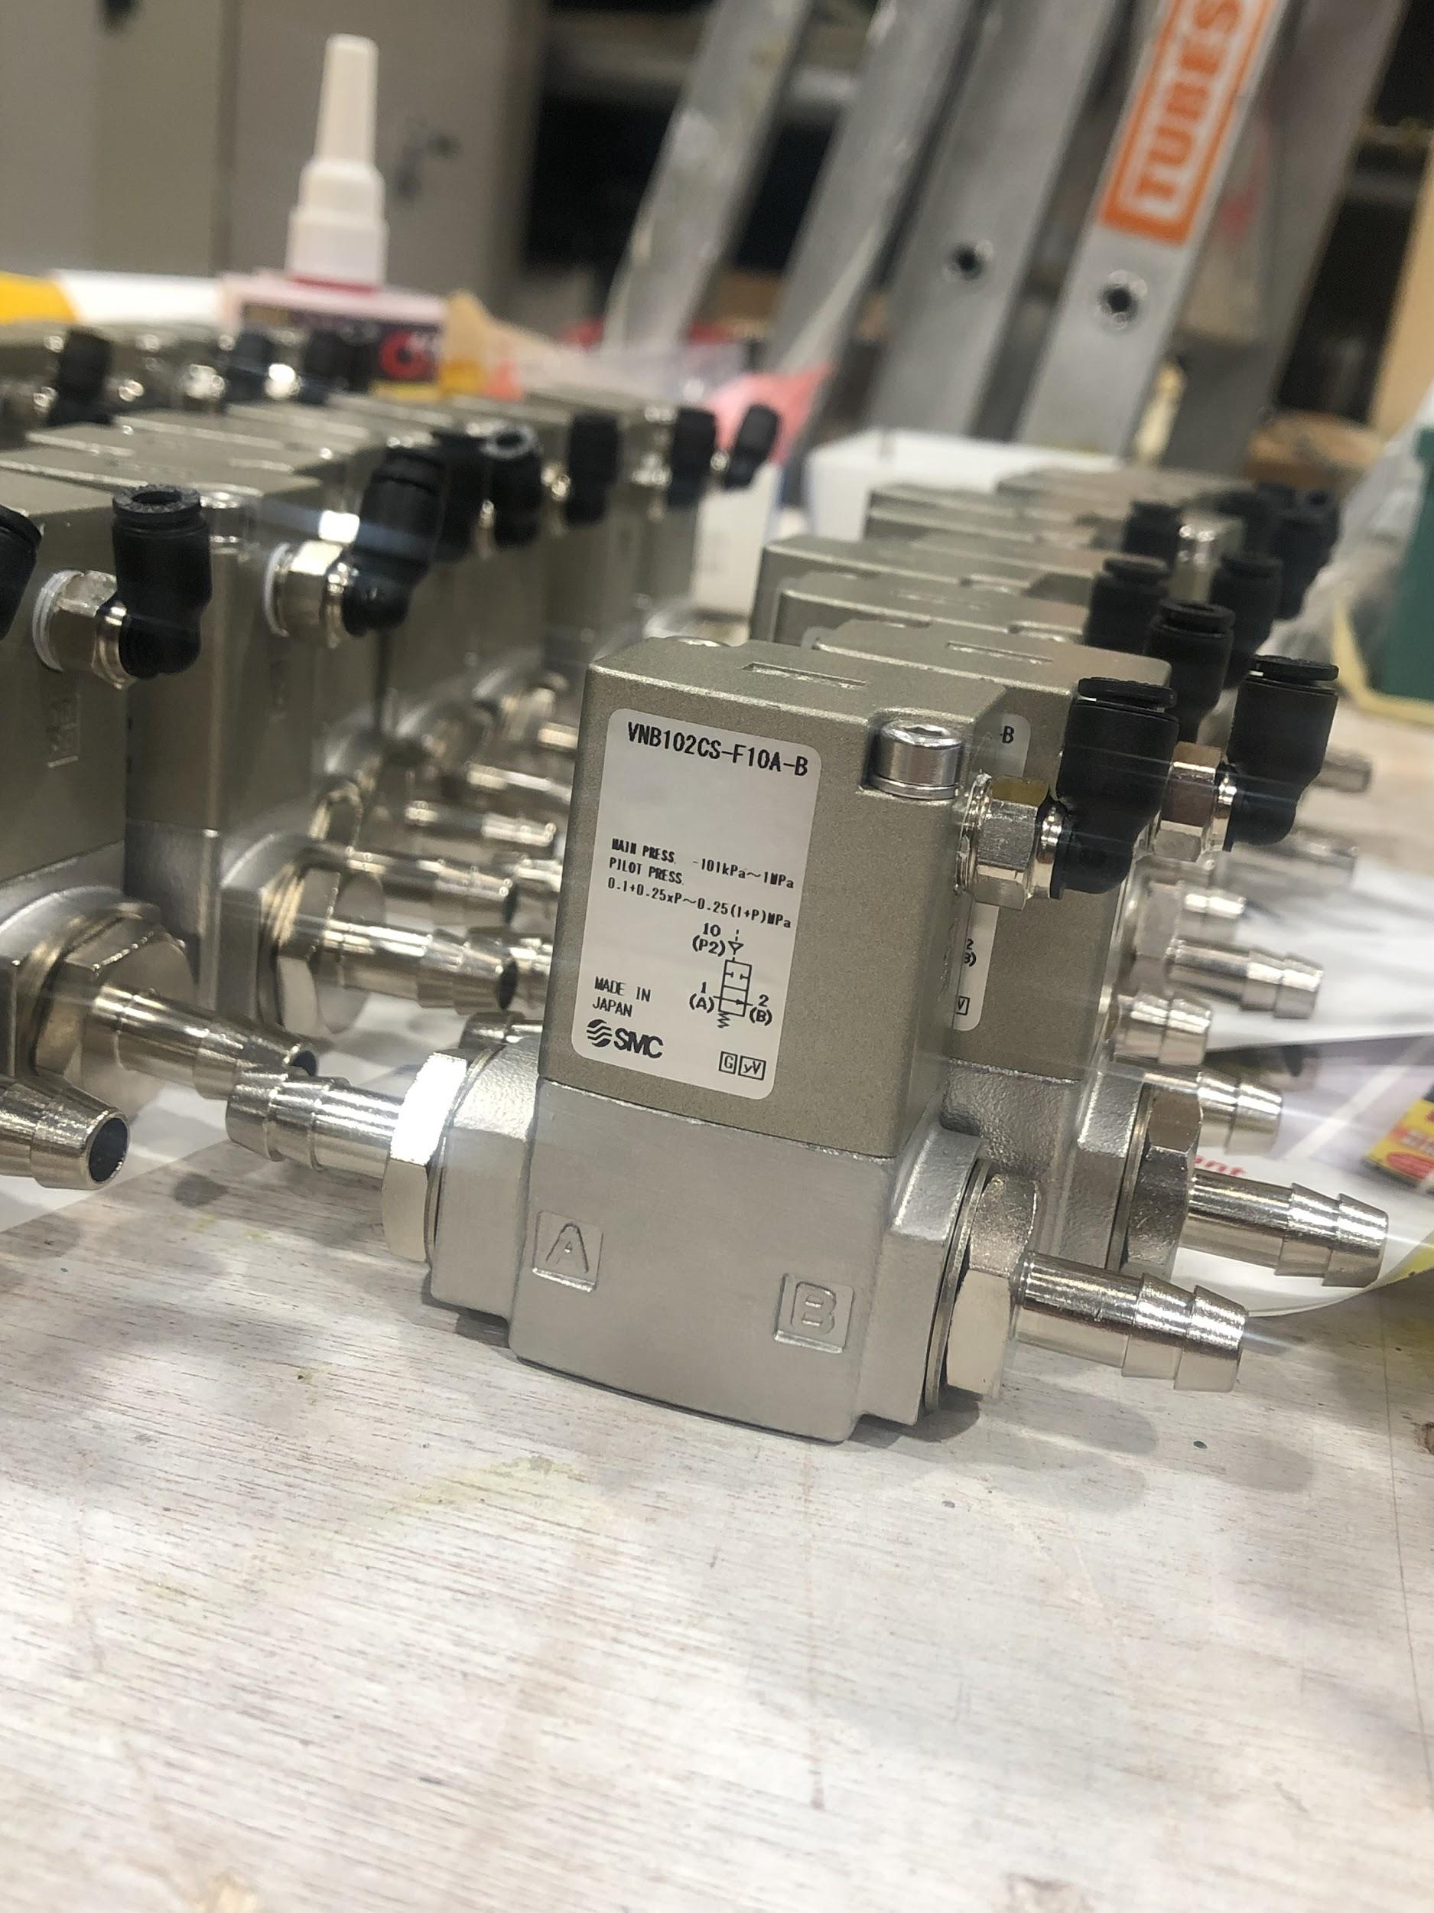
Building and Testing Valves
Add non-magnetic and radiation-resistant screws
Attach valve nozzles with adhesive, let valves sit for >24 hours so that seal adhesive has time to dry
Test seal quality under pressure. If valves pass, they are ready to be installed
Since last update we have assembled over 120 with 0 failures
We have ~20 spares

Slide 7
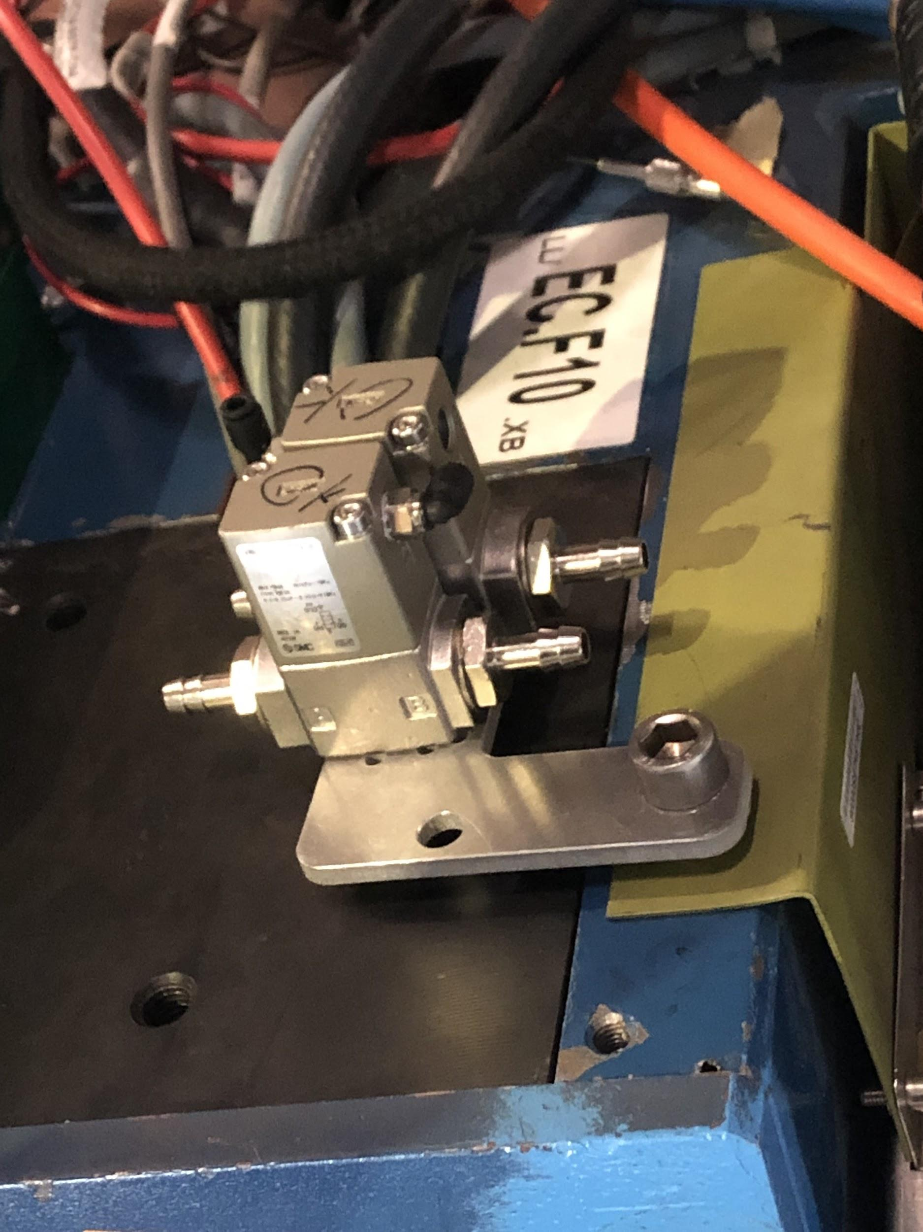
Mounting Valves
Mounting plates attach to close to finger
Orientation is critical!
Hoses must be able to reach valve nozzles without bending too much
Valve nozzles must not be too close to walls/other wires
Ideally plates should be secured with two bolts, but sometimes that is not possible

Slide 8
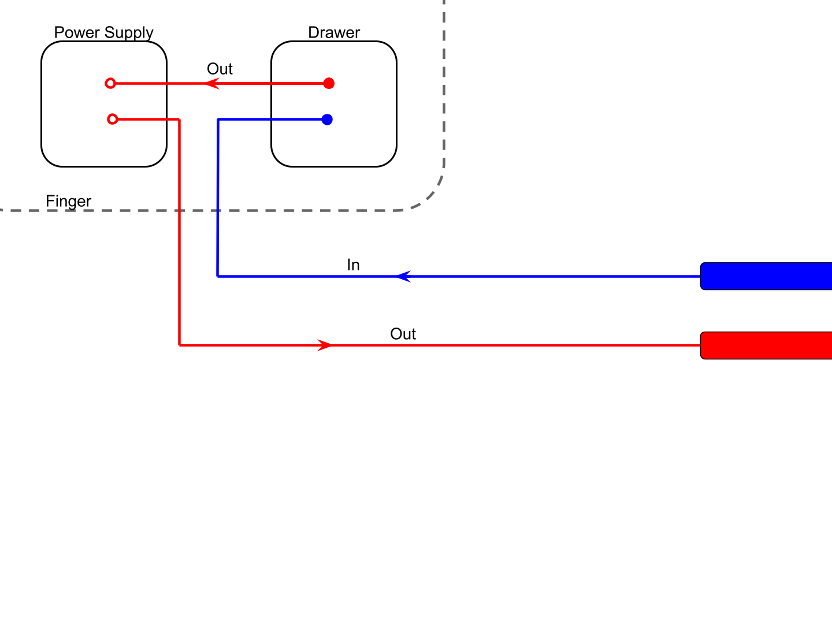
Initial Hose Connection
Pipes

Slide 9
Method
Disconnect hoses here -- don’t touch the hoses inside the drawer. Cut new hoses and fit their end to the in/out pipes.

Slide 10
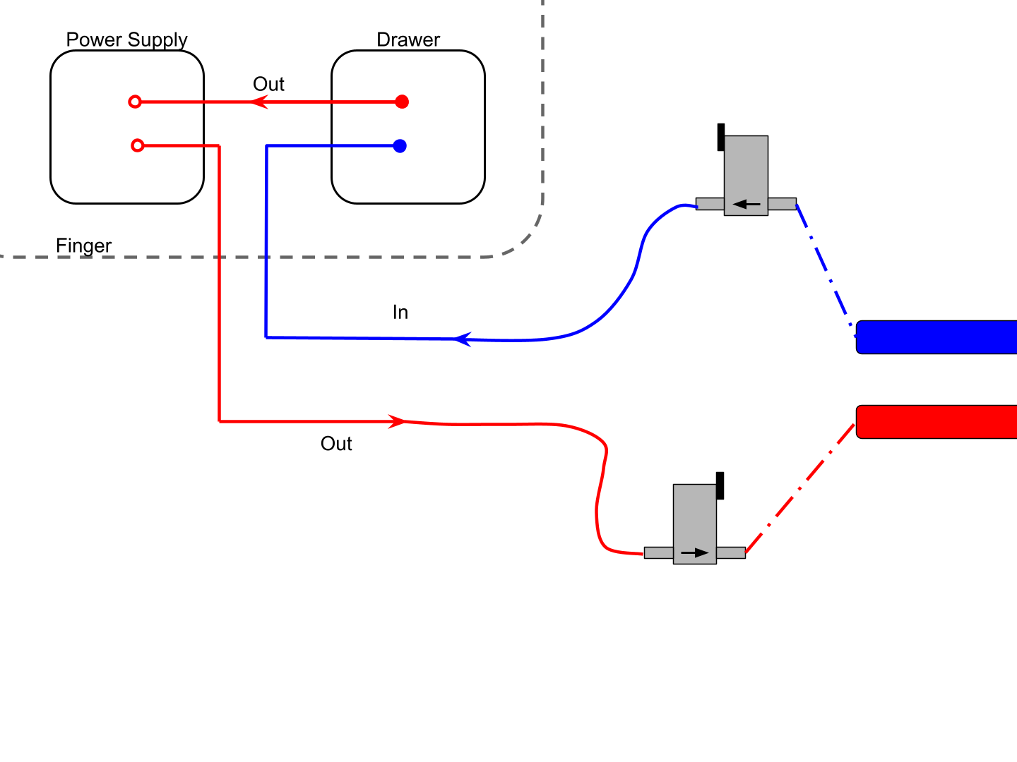
Method

Slide 11
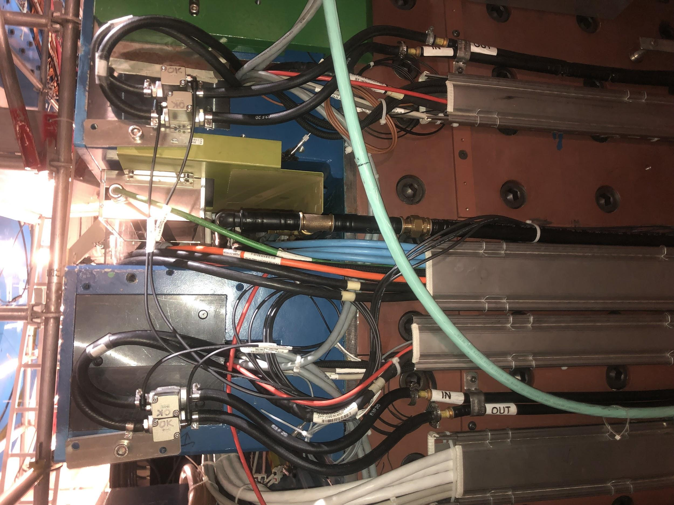
Examples

Slide 12
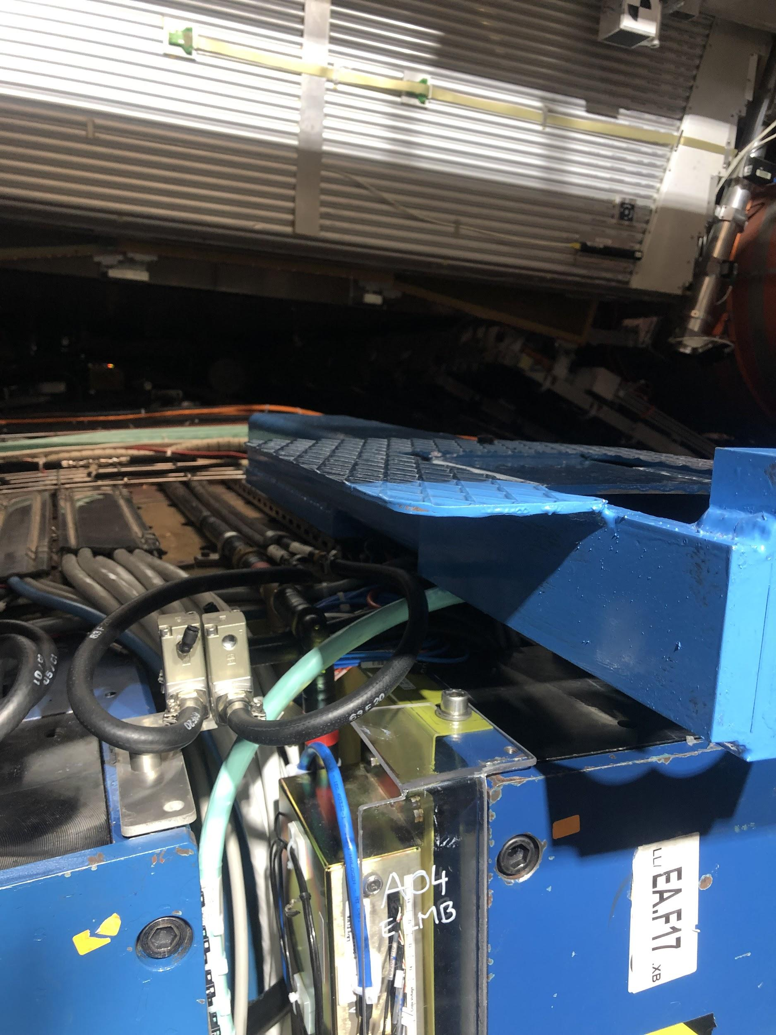
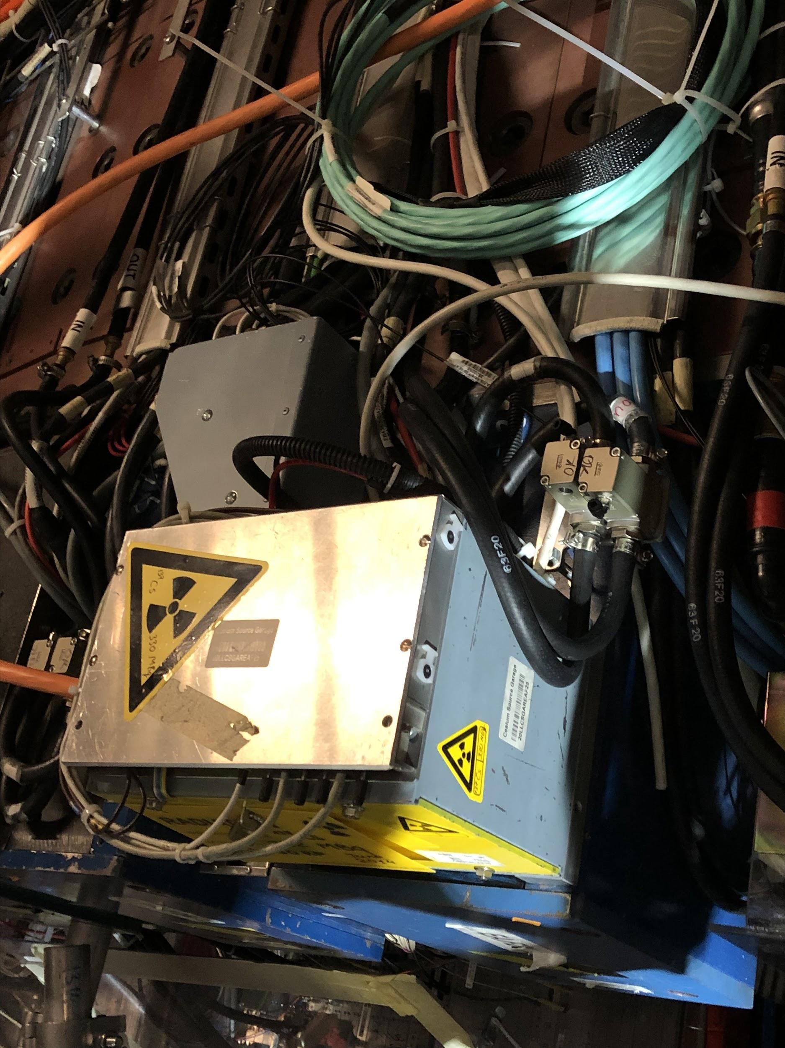
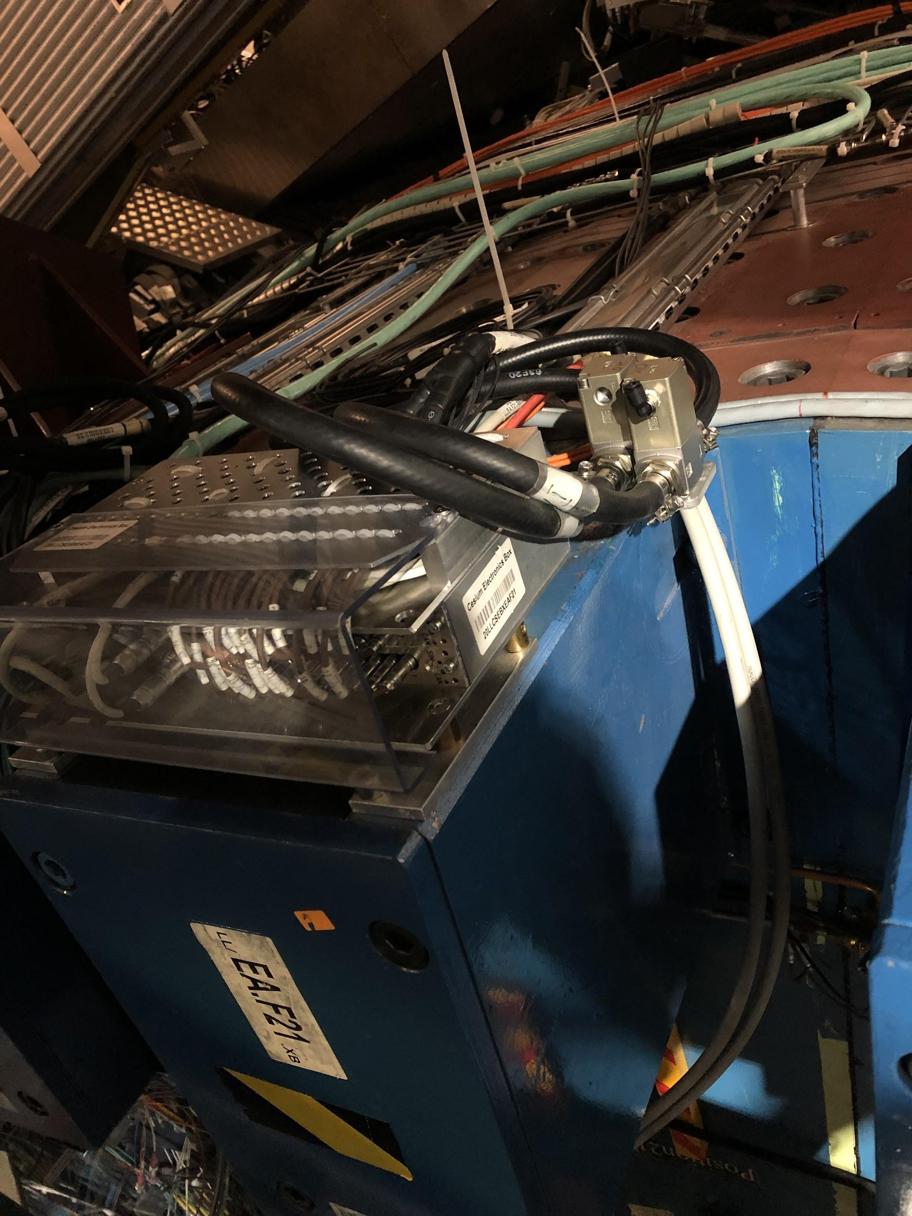
Examples (more complicated)
Middle Beam
Cs source box
Cs electronics box

Slide 13
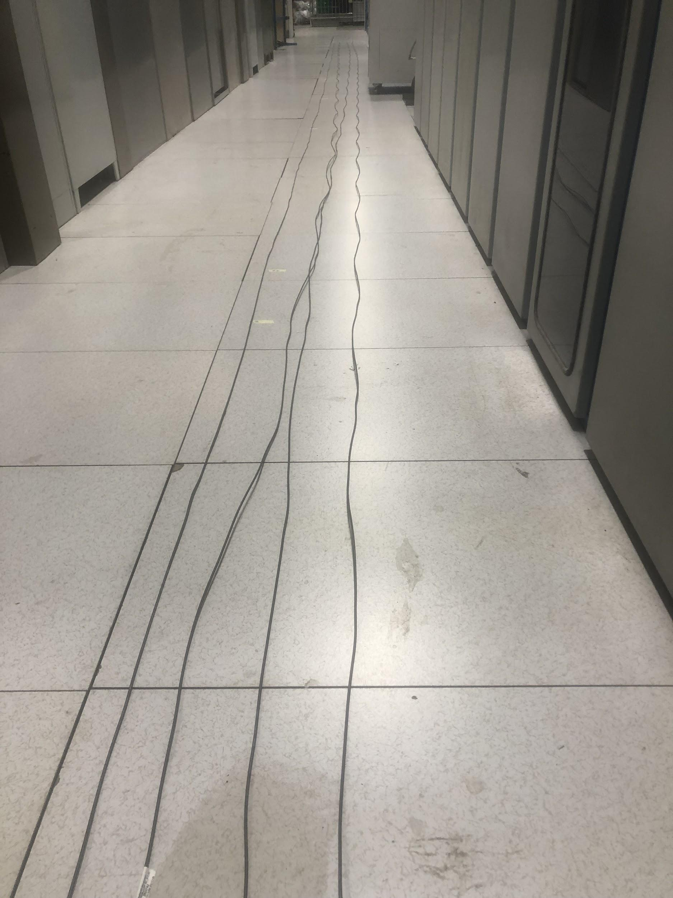
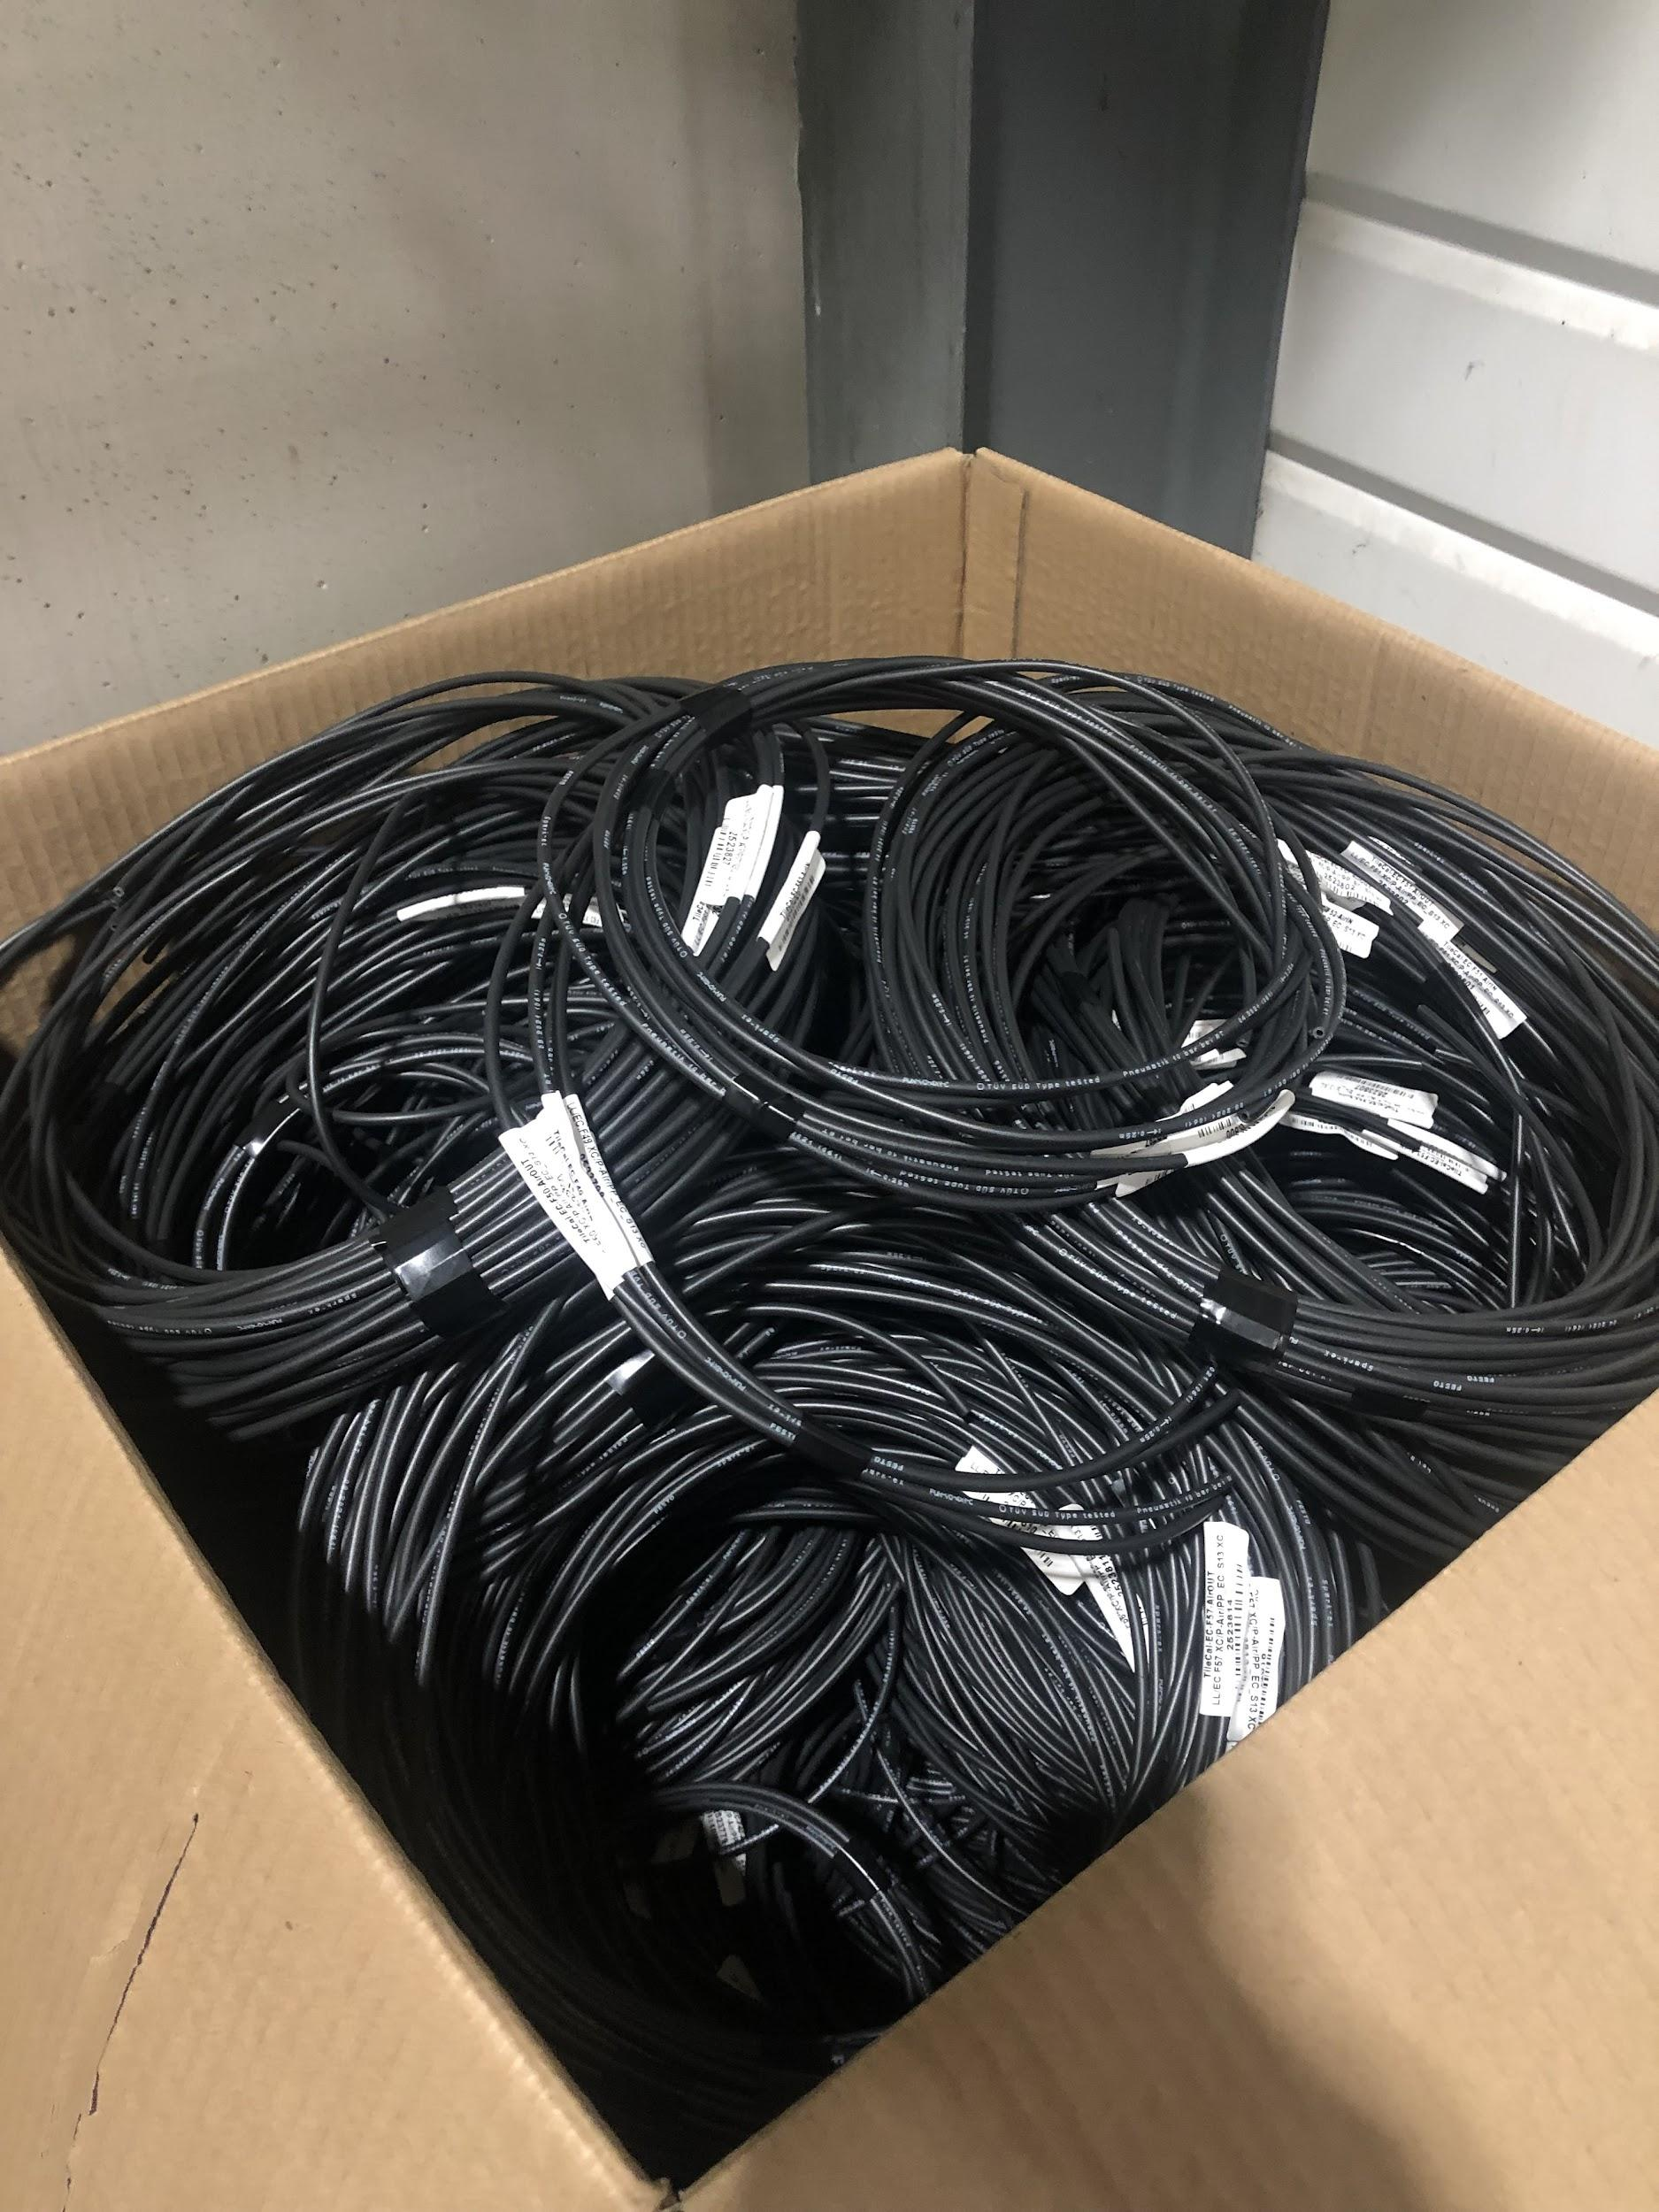
Air Hoses Preparation
We measured out all the hoses to be installed on EBC (as well as many for EBA)
They were all labeled and bundled

Slide 14
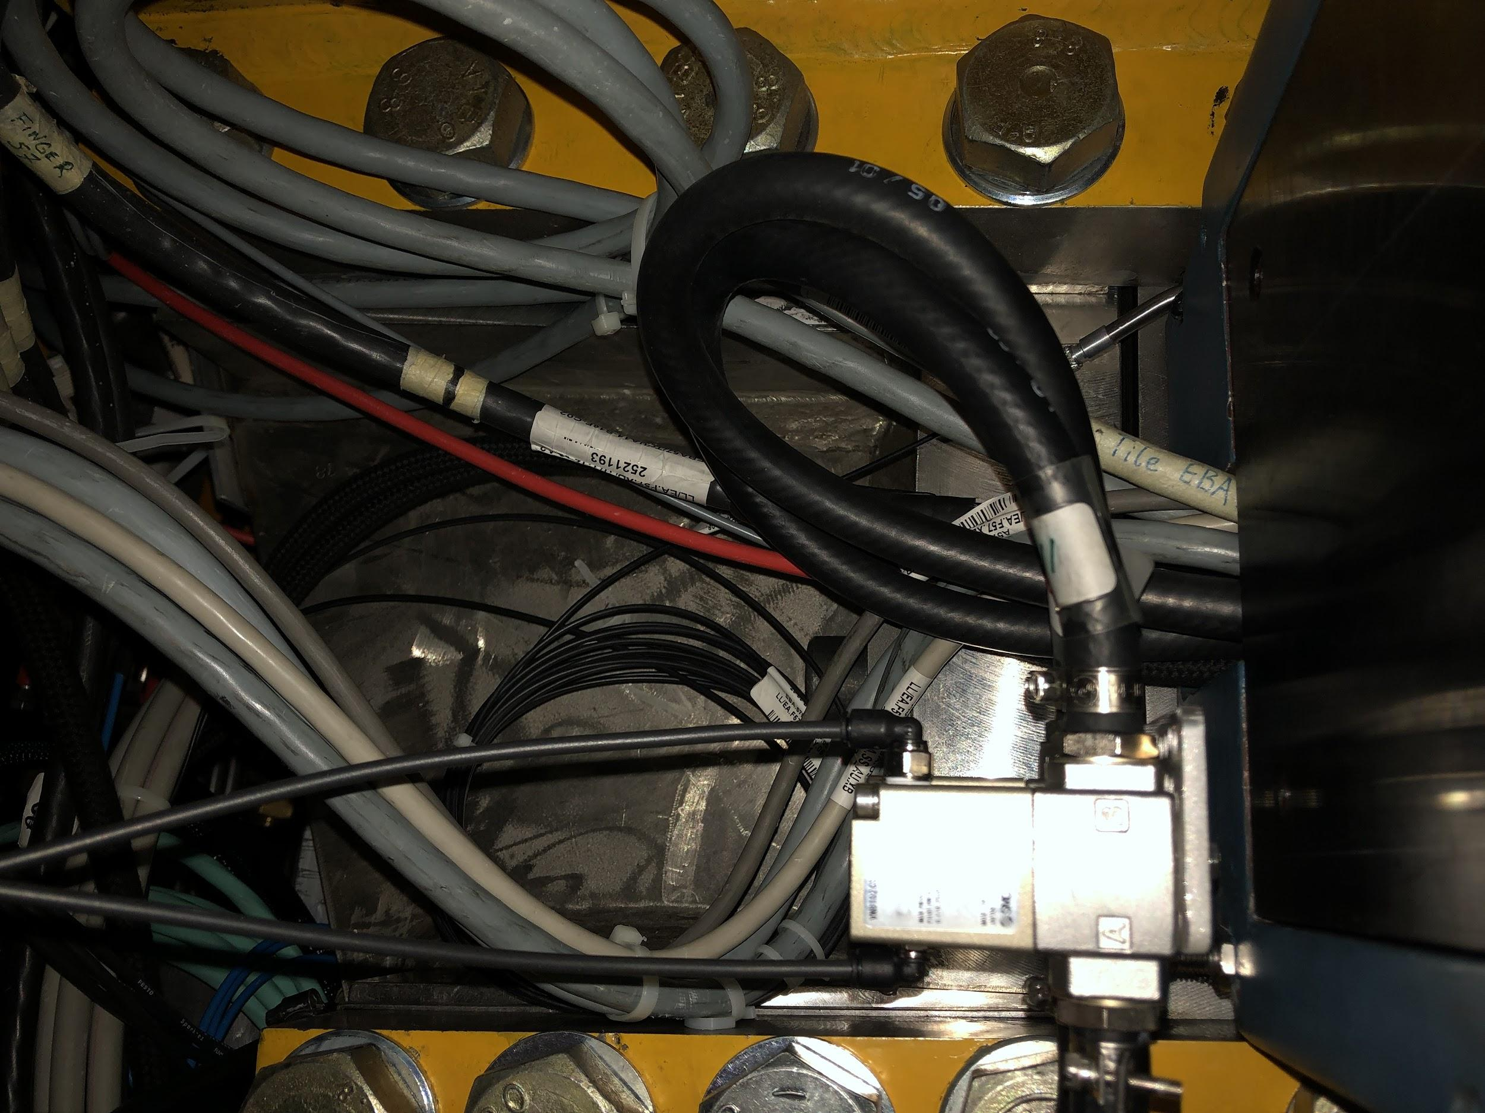
Connecting air hoses
Hoses were run around the outside of the detector to the patch panel by another team
We went around and plugged each one into the appropriate valve on EBA and EBC (LB already done)

Slide 15
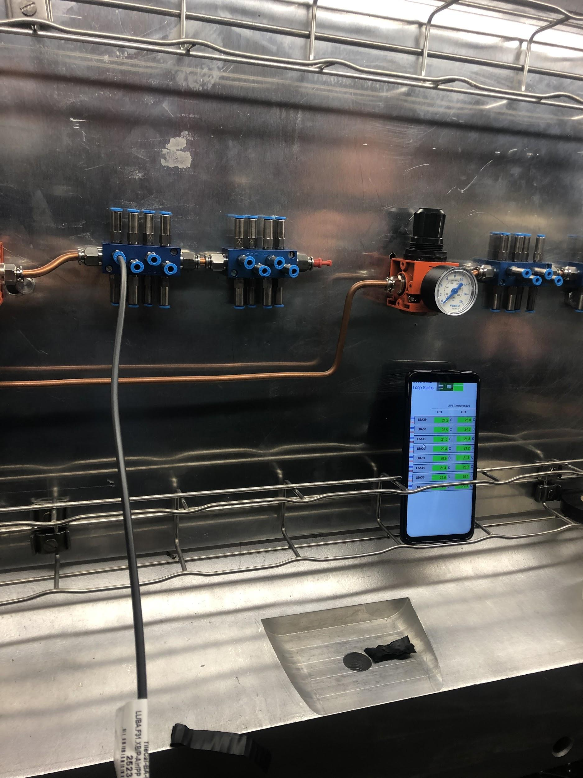
Commissioning
Hoses are gathered near a patch panel where they can be connected to a pressurized system
We check the in and out hoses for each module separately, and confirm they both increase the module’s temperature using DCS monitoring
Completed on both EB and LB

Slide 16
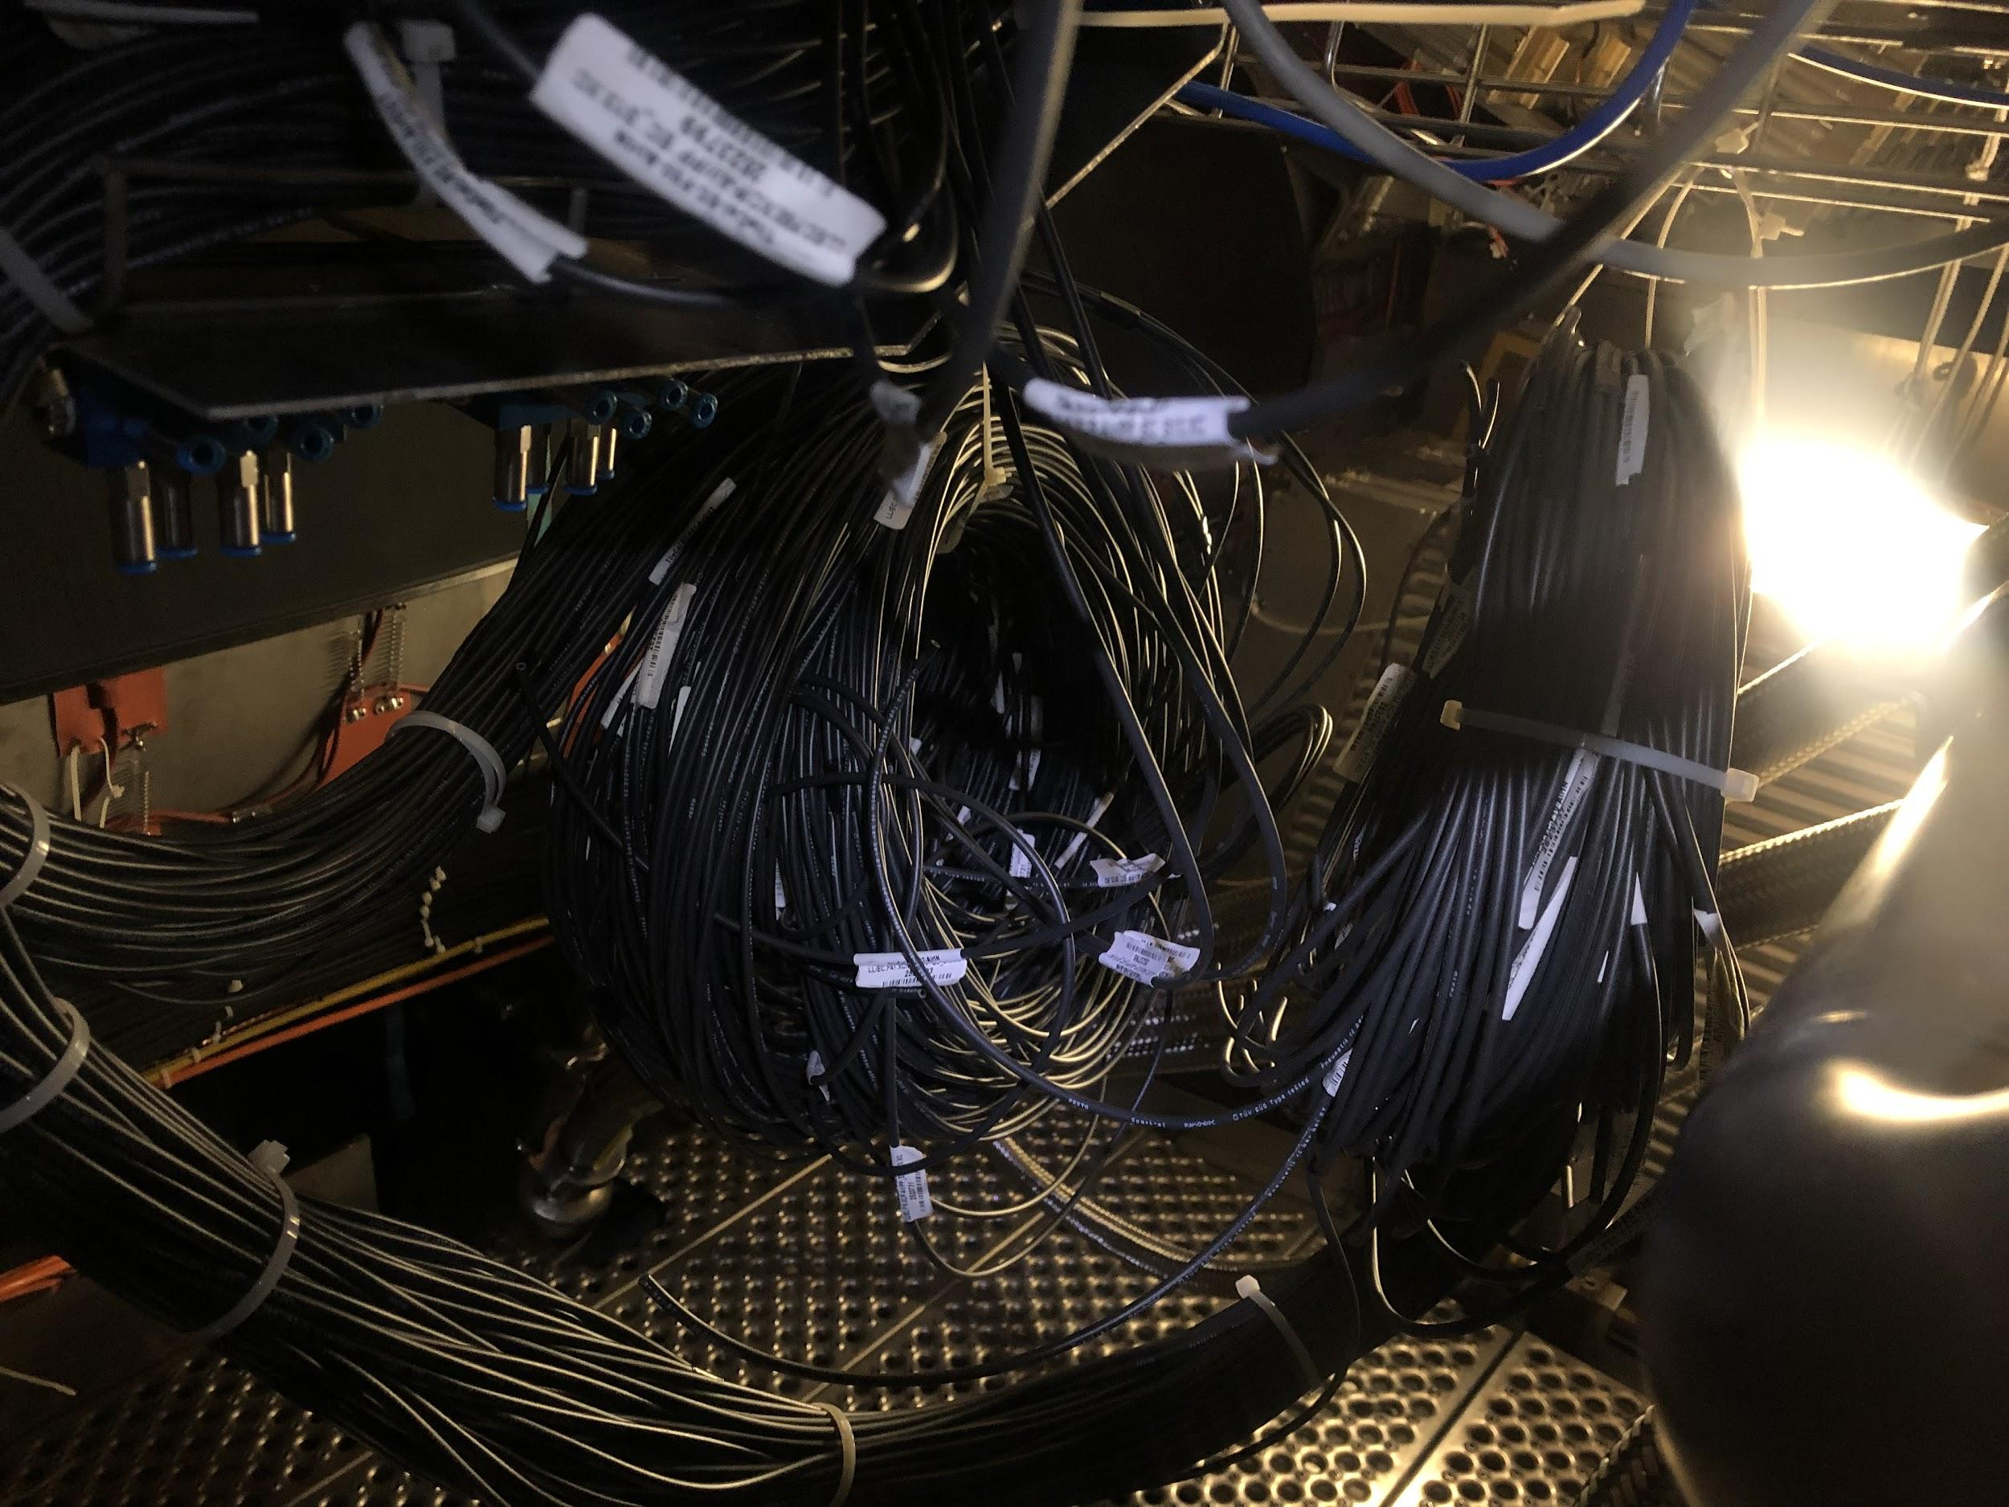
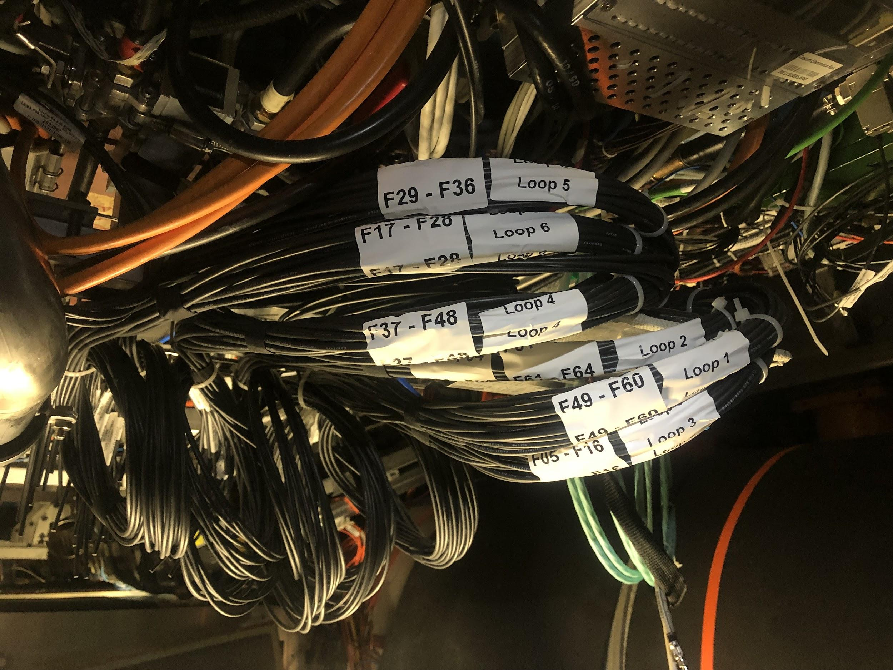
Final Touches
All measurements given for the hoses on EBA and EBC seemed to be about 1-2 m too long once run around the detector, so we trimmed and relabeled them all.

Slide 17
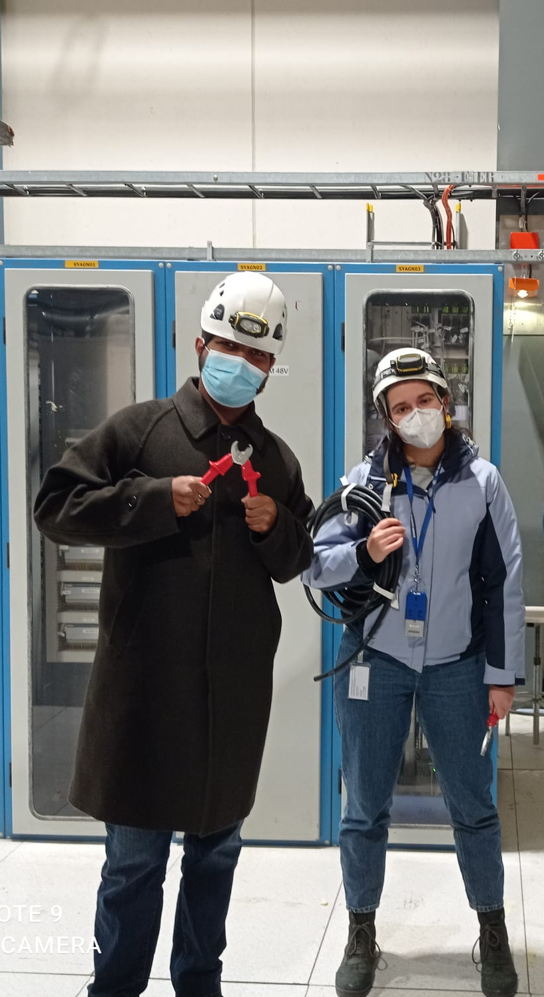
Current Status
All 4 partitions have valves on every module! (512 total valves installed)
We were responsible for EB
Previous Chicago Techs responsible for LB
All valves connected to air hoses and have been commissioned.
There are about 20 extra valves if any need to be replaced in the future.

Slide 18
Maintenance
Notes:
Take everything from ELOG starting from Oct. 6

Slide 19
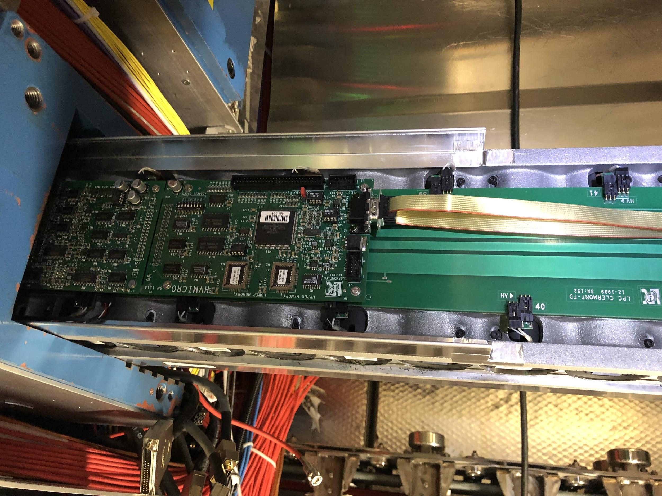
Drawers Opened
LBC 18: Opened Nov 10 CANbus line fixed
LBC 55: Opened Nov. 8, no problems
LBC13: Opened Nov 10 to replace digitizer
LBA 52: Opened Nov 19 due to dig errors
LBC 59: Opened Nov 19 to replace HV divider
LBA 21: Opened Nov 26 to replace digitizer
EBC 58: Opened Dec 10 to replace 3in1 card
LBA 58: Opened Jan. 7 to replace HV micro
LBC 33: Opened Jan. 20 to fix cooling problem
EBC 48: Opened Jan. 25 to fix cooling problem
EBC 49: Opened Jan. 25 to fix cooling problem
LBC 49: Checked with integrator and DVS tests, Jan 22

Slide 20
Cooling Issues January 2022 - detector closing
Oleg Solovianov
Ludovico Pontecorvo
Stanislav Nemecek
Antonio Cervello Duato
Merve Nazlim Agaras
Dawit Mesfin Belayneh
Katherine Rees Hughes
Filipe Manuel Pedro Martins
Irakli Minashvili

Slide 21
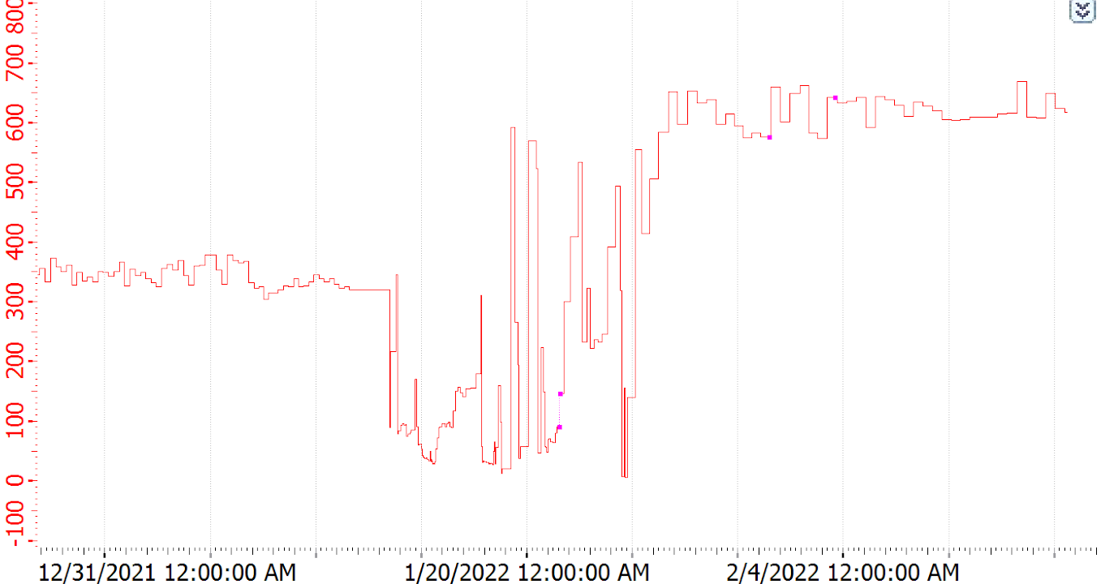
LBC33, LBC49, EBC48 and EBC49 fixation. 19-23 Jan
Maintenance of cooling station + EBC closer
11-12 January
PPV Cycle (min)
January-February 2022
EBC closed
24th January
EBC opening
13 January
Conflict with diffusion pump cables
LBC60 isolation valve rubber hose connection damaged by metallic PIN (on the EBC)
24th January

Slide 22
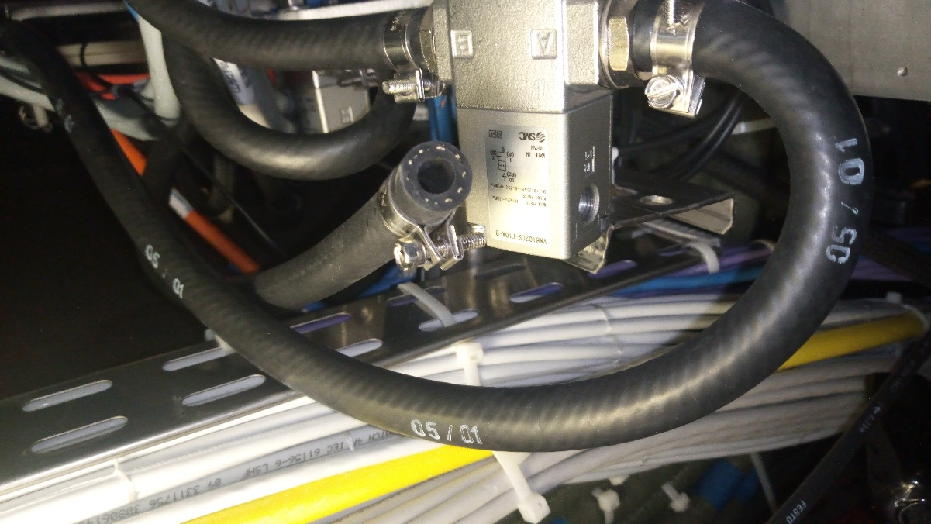
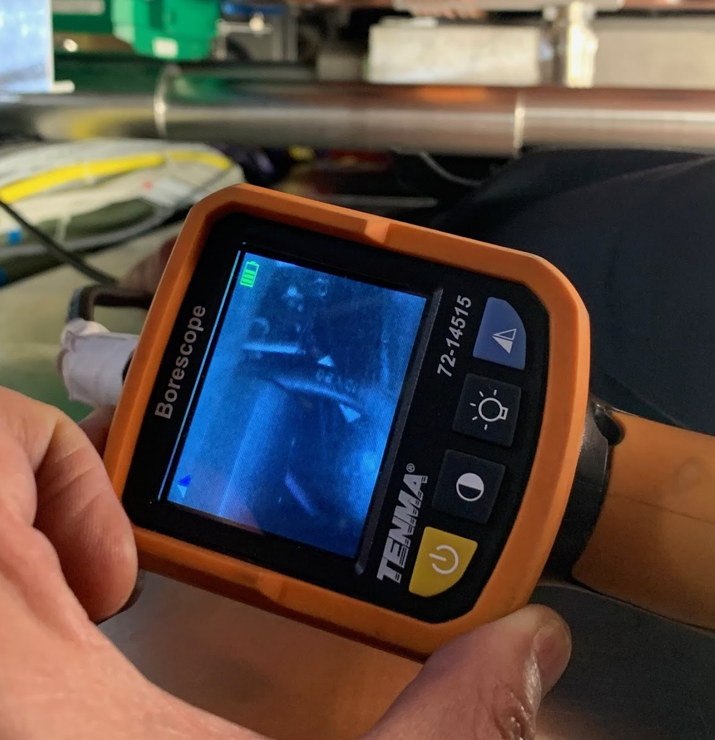
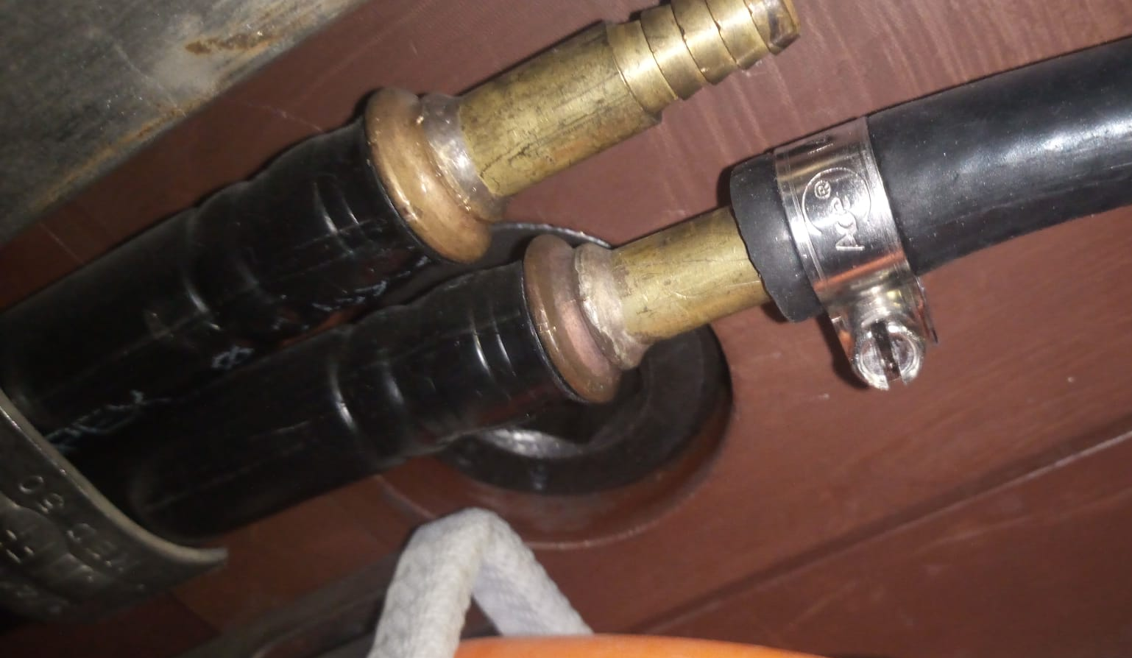
Rubber hose
Metallic PIN

Slide 23
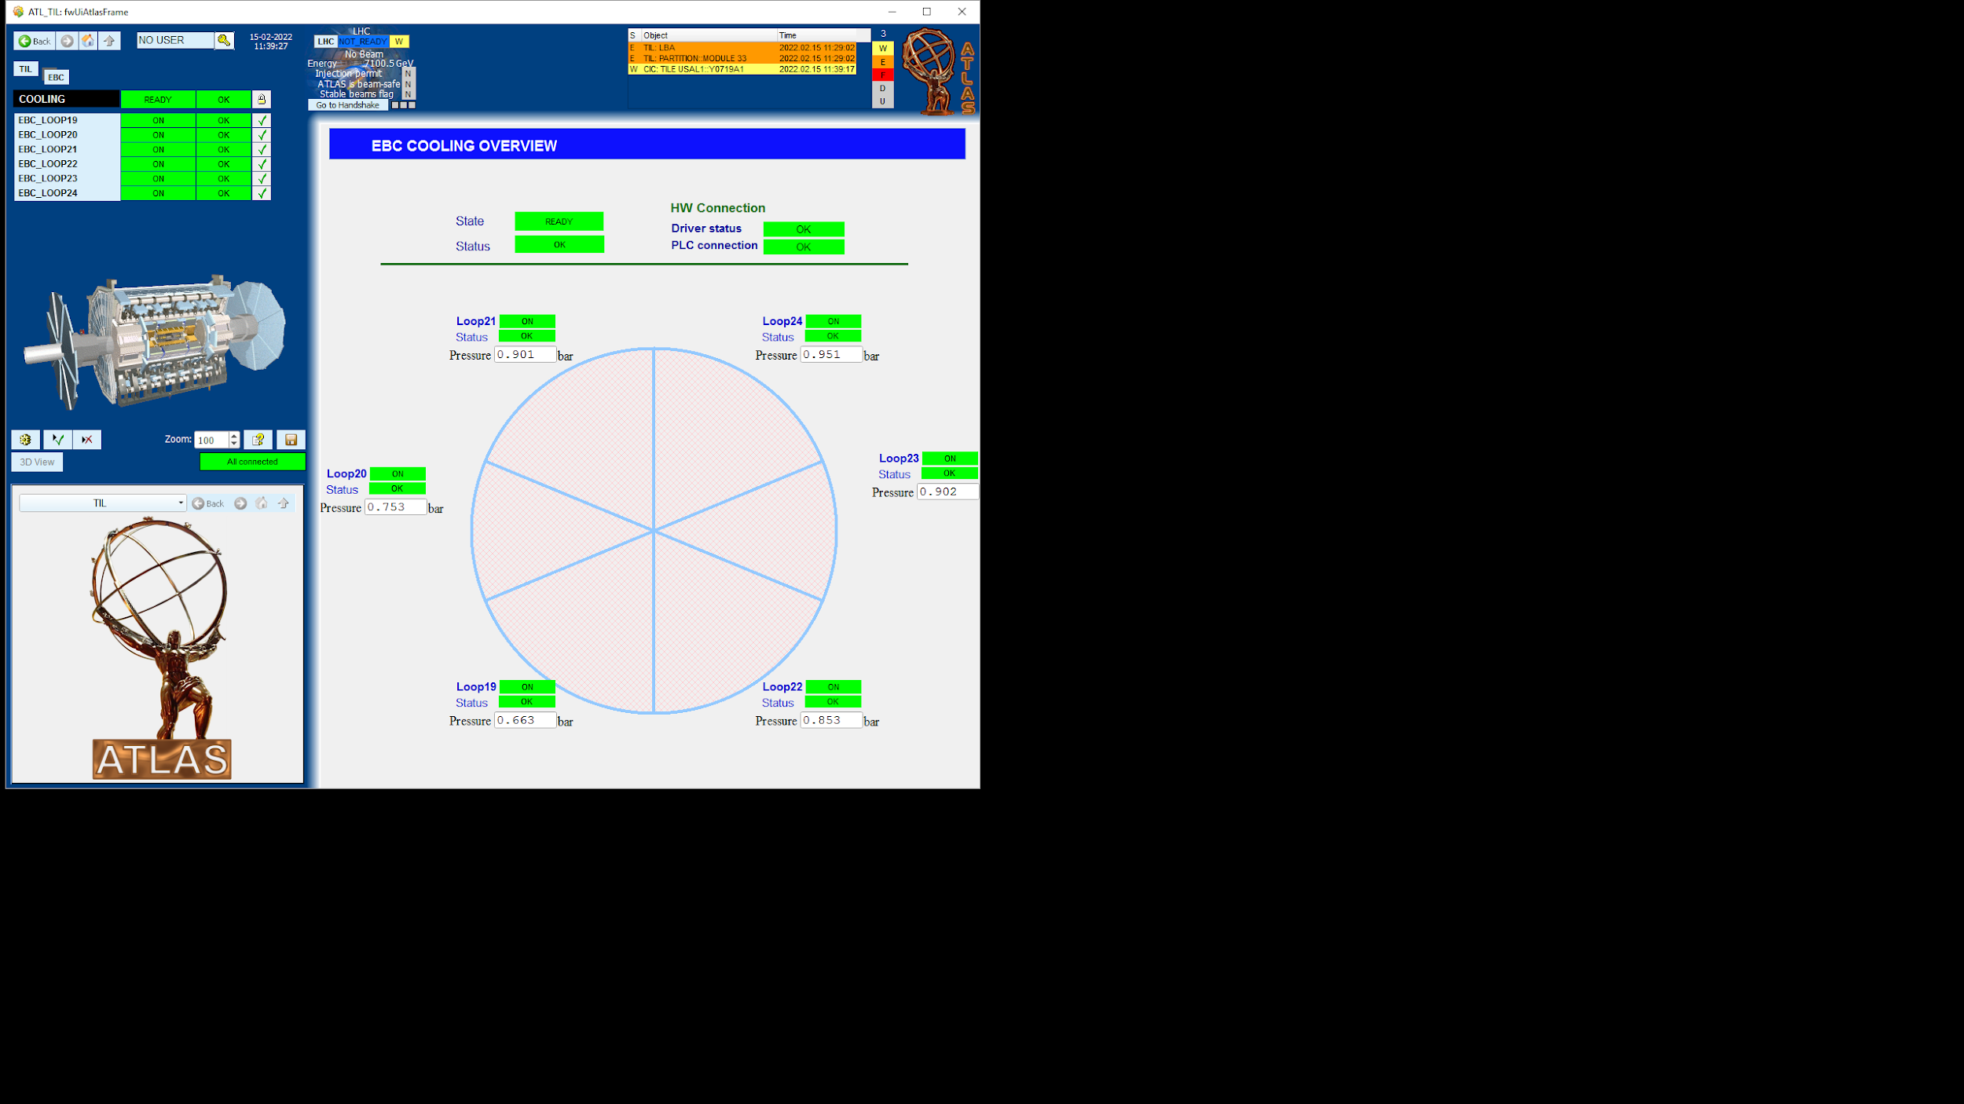

LBC60
LBC33
EBC49
EBC48
LBC49

Slide 24
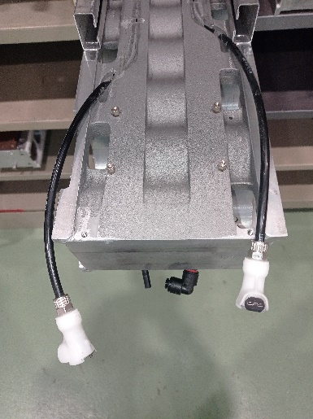
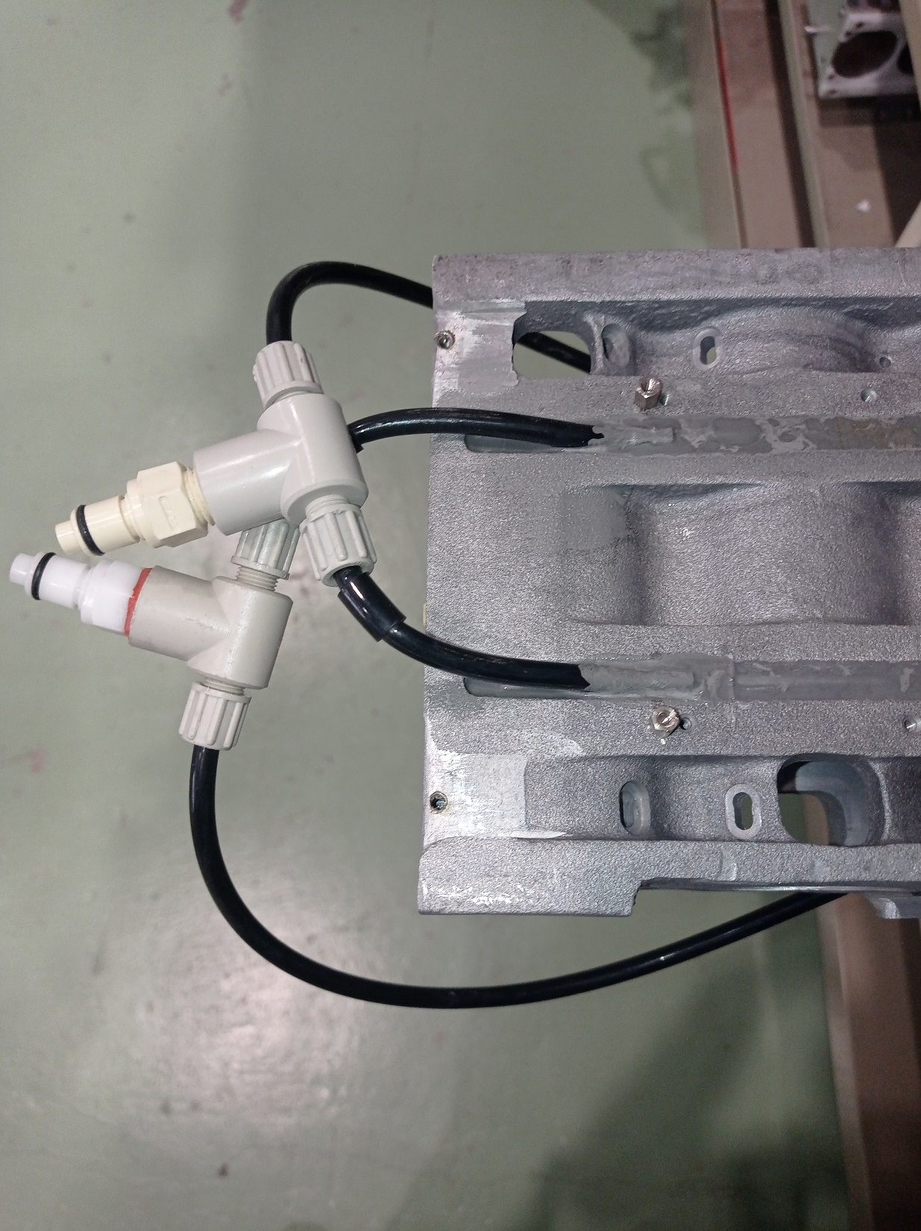
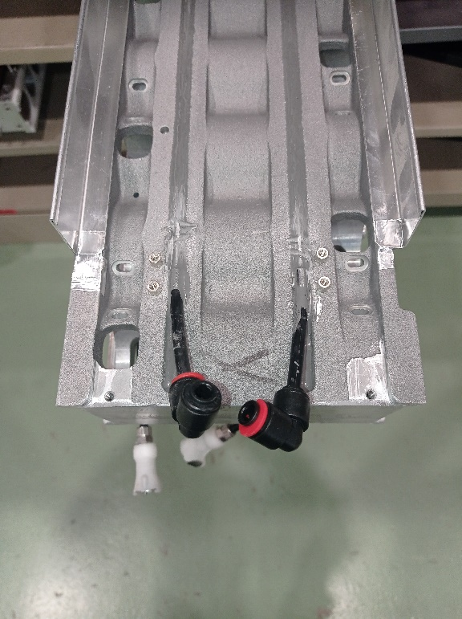
Internal Cooling of Tile Supper Drawer
MB-Side
IN
OUT
HV-Side

Slide 25
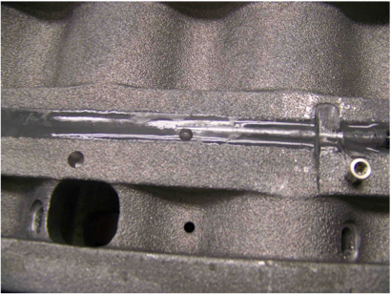
Cooling leak (EBA04) 2009
Metallic pipe corrosion

Slide 26
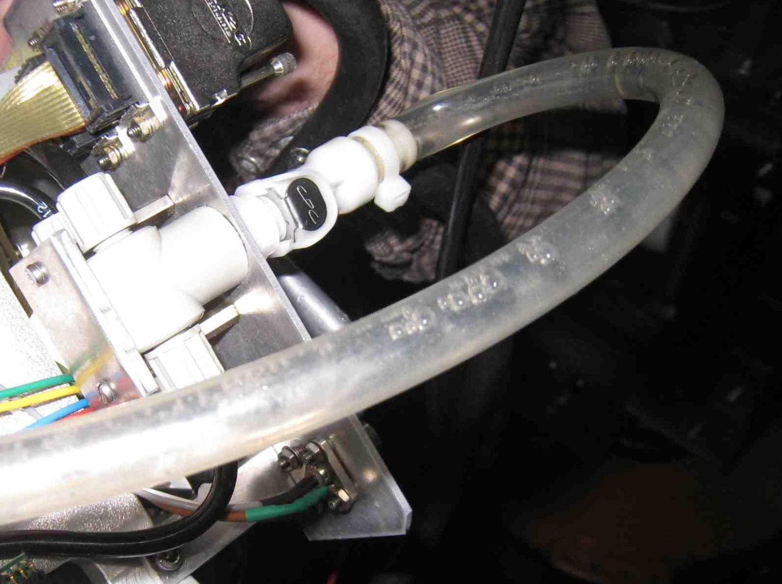
Some special cases (LBA 56) 2012
The water leak problem was in the internal drawer but was impossible to precisely located it.
After several days, SD was inserted but ¼ of the SD has no water flow (a bypass was installed preventing the water to flow in the internal drawer – MB side)
No increase in temperature is seen in DCS.
The PPV cycle of the cooling loop increased from 250 min to 350 min.
Air bubbles
PPV: Elapsed time between vacuum pump cycles.

Slide 27
 | Module | Date | From cooling disconnected | Impact in PPV cycle
1 | LBA56 | Jan. 2012 | MB internal | 100min (250🡪350min)
2 | EBA51 | March 2020 | ½ HV External | 30min
3 | LBC14 | April 2021 | MB external + HV internal | 100min
4 | LBC64 | Dec. 2021 | MB Internal + HV Internal | 50min
5 | LBC01 | Dec. 2021 | MB internal | 50min
6 | LBC33 | Jan. 2022 | HV side (internal + external) | 100min
7 | LBC49 | Jan. 2022 | HV side (internal + external) | 100min
8 | EBC48 | Jan. 2022 | HV side (internal + external) | 100min
9 | EBC49 | Jan. 2022 | HV side (internal + external) | 100min

Slide 28
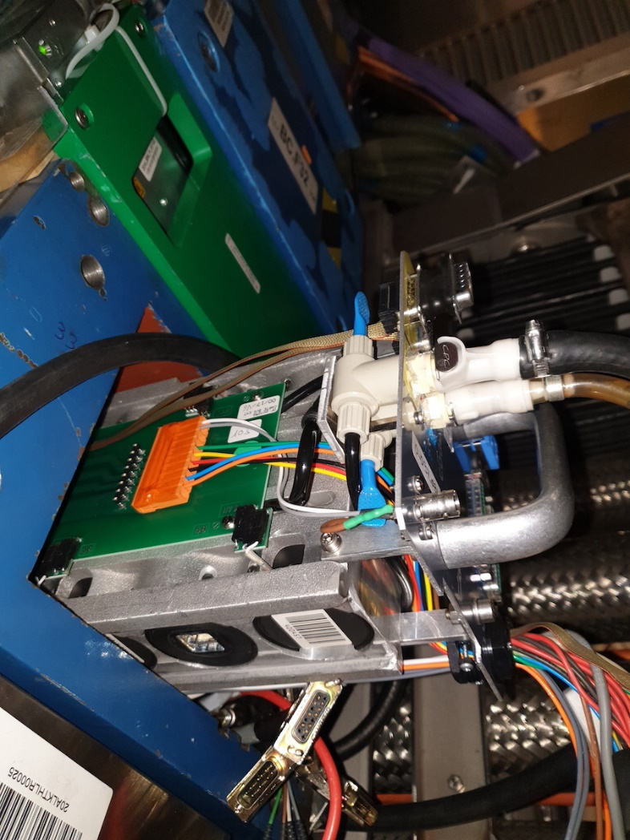
Internal Cooling of Tile Supper: Drawer HV side excluded
MB-Side
IN
OUT
HV-Side

